Slide 1

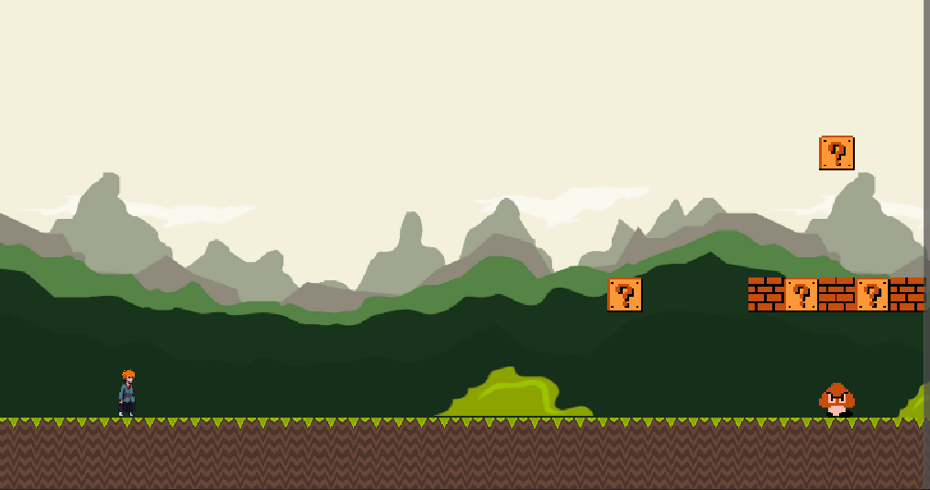
Game Programming Mystery Quest: Coins and Power-ups
Team Members:
Shobith Paripalli (21BAI1722)
Kalyan Chakravarthy (21BAI1759)
Aasrith Dogiparthi (21BAI1702)

Slide 2
Gameplay Mechanics Overview
Player Mechanics:
The player can run, jump, and interact with mystery blocks. The blocks contain coins or power-ups that affect the player’s abilities.
Power-ups: The player can grow in size after hitting a mystery block or become invincible for a limited time. These power-ups add variety and strategic depth to the gameplay.
Running Animation: A fluid and responsive running animation is integrated, adjusting based on the player’s movement speed. This enhances player immersion and creates a more polished feel.
Enemy Mechanics:
Enemies have simple patrol patterns and damage the player on contact. The player can jump on them to defeat them.
Enemy Death Animation: A custom animation plays when an enemy is defeated, showing it shrinking and disappearing. This visual cue reinforces the player’s action and adds polish.
Mystery Block Interaction:
Mystery blocks can be hit from below, giving players rewards such as coins or power-ups. These blocks are strategically placed to encourage exploration and interaction.

Slide 3

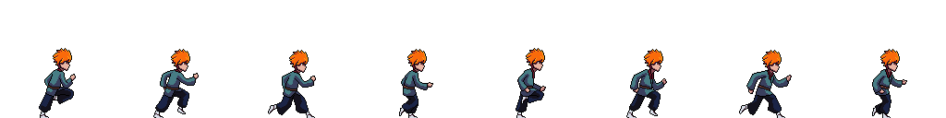
Art and Visual Design Progress
Player:
The player’s base design is a small, agile character with a bright, colorful style suited for the platformer genre.
When powered up, the player grows larger and gains a visual effect when invincible, signifying the enhanced abilities clearly to the player.
Running Animation: The running animation consists of multiple frames, creating a fluid and natural movement. This is synchronized with player speed, ensuring smooth transitions.
Death Animation: A short animation that plays when the player dies, with the character falling and fading out, giving a clear indication of defeat.

Slide 4

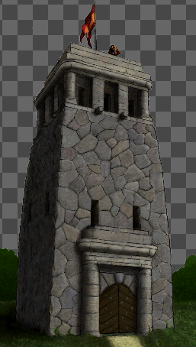


Enemies:
Enemies have varied designs, small walking enemies.
Environments:
Background: A vibrant, cartoon-like background with skies, tiles and bushes. The environment is designed to be engaging yet not distracting, keeping focus on gameplay.
Platforms: Detailed platform tiles, with variations for grass, stone, and other materials to keep the levels visually interesting.
Power-Ups: Mushroom and Star shaped power-ups. The mushroom makes the player big and the star give invincibility.

Slide 5
Story and Narrative Development
Storyline:
The game’s story follows a brave adventurer exploring a mysterious land filled with treasure and danger. The player’s goal is to navigate through different levels, collecting coins and using power-ups to overcome obstacles and enemies.
Each level introduces new challenges, with enemies becoming tougher and more varied as the player progresses.
Character Arcs:
Player: A heroic figure seeking treasure, with an implied backstory of exploration and adventure. As the player progresses, their power-ups reflect their growth and newfound abilities.
Enemies: Creatures guarding the treasure, with different designs based on their difficulty and level.
Narrative Adjustments:
The story is flexible, allowing for additional characters or plot twists, such as
the introduction of a final boss or secret areas.

Slide 6
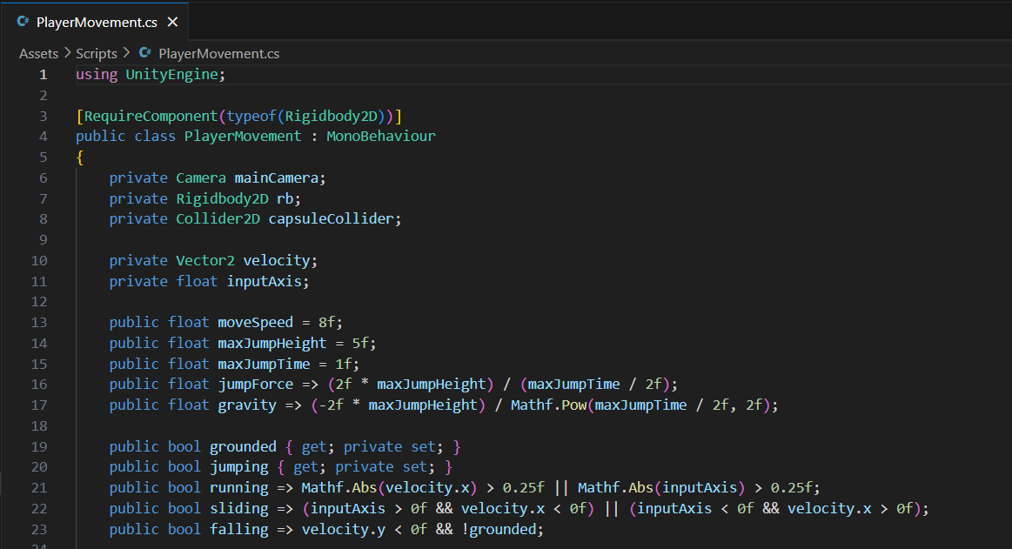
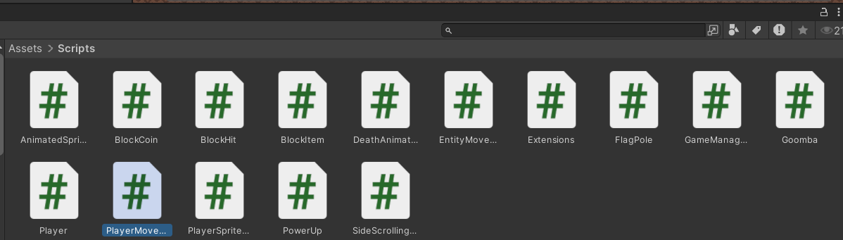
Technical Achievements
Achievements:
Power-up System: Fully functioning power-up mechanics, allowing the player to grow bigger or become invincible after hitting a mystery block. Including a timer that reverts the player back to normal after a set duration.
Animations: The player’s running, and death animations are fully implemented, creating a more immersive experience.
Enemy Interactions: Implemented basic enemy AI with patrol patterns and collision-based damage to the player.

Slide 7
Demo and Next Steps
Demo Run:
Current Build: Present a demo of the current state of the game, focusing on core mechanics like player movement, enemy interactions, power-up collection, and mystery block functionality. Show how the running animation looks in motion, as well as the death animation when the player is defeated by an enemy.
Link: https://drive.google.com/drive/folders/1mG-rRED4iQkQ34kC4Hbx5LHuTjL9KPJu?usp=drive_link
To Be Done:
Sound Effects: Adding sound effects for player actions, such as jumping, hitting blocks, collecting coins, and interacting with enemies.
Canvas: Implementing the Canvas UI for displaying score, health, and power-up status clearly on screen.
New Level: Possibly adding a new level with unique challenges, new enemy types, and different environmental hazards. This will allow for more varied gameplay and introduce new mechanics.

